Slide 1

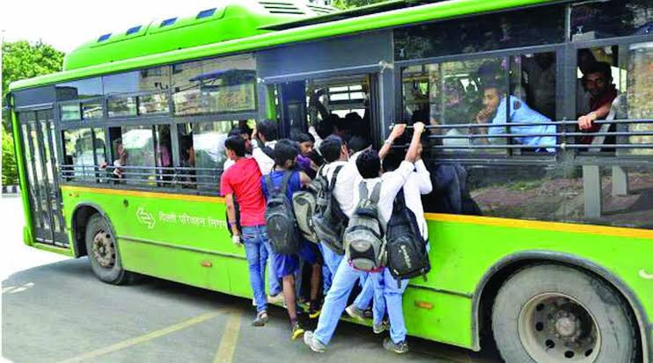
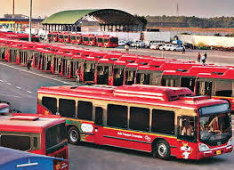

DTC Bus Guide
By :
Jitendra Kumar Sharma
02815002717

Slide 2
Needs :
The need of this project is due to the fact, that people in Delhi are not familiar with the bus routes in Delhi, as they are very complex. Most of the people are unaware that which bus to board and where to interchange to reach their destination by applying minimum efforts, according to their needs.
Due to the unavailability of proper application for a DTC bus, this application is a must for people who occasionally or are new to Delhi Public Transport.

Slide 3
Objective :
Collect the data from the web to complete your database and store it as required.
Implement Trie to store all the Bus stand, for better search results.
Make a graph for the Delhi bus route.
Implement appropriate algorithm to find the route with minimum bus stops.
Implement appropriate algorithm to find the route with minimum changes.
Enhance efficiency.
Implement a user-friendly Interface
Make an application that is platform-independent.

Slide 4
Graph :
Graphs are mathematical structures that represent pairwise relationships between objects. A graph is a flow structure that represents the relationship between various objects.
It consists of the following two components: 1. A finite set of vertices also called nodes. 2. A finite set of ordered pairs of the form (u, v) called as edge. The pair is ordered because (u, v) is not same as (v, u) in case of a directed graph(digraph). The pair of the form (u, v) indicates that there is an edge from vertex u to vertex v. The edges may contain weight/value/cost

Slide 5
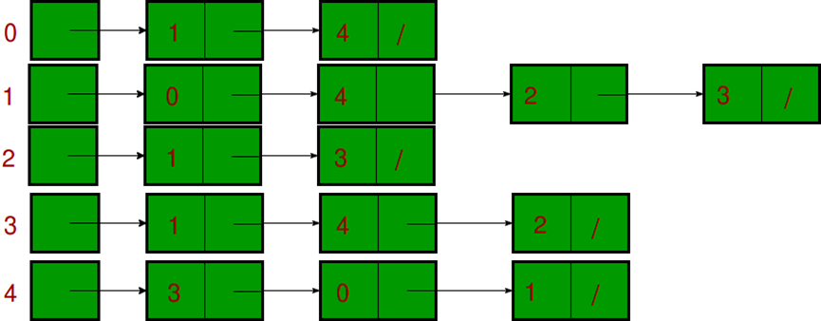
Graph virtual representation
Graph representation used : Adjacency list

Slide 6
Trie data structure
A Trie is a special tree-like data structure, wherein characters of a string are stored as nodes. Trie is an efficient information reTrieval data structure. Using Trie, search complexities can be brought to an optimal limit (key length). If we store keys in the binary search tree, a well-balanced BST will need time proportional to M * log N, where M is maximum string length and N is number of keys in tree. Using Trie, we can search the key in O(M) time.
It consists of nodes and edges. Each node consists of a maximum of 26 children and edges connect each parent node to its children. These 26 pointers are nothing but pointers for each of the 26 letters of the English alphabet A separate edge is maintained for every edge

Slide 7
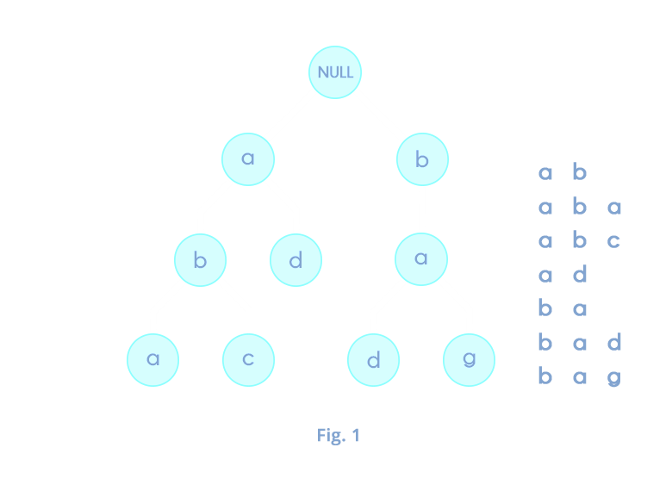
Trie
Representation

Slide 8
Breadth-First Search:
A breadth-first search (BFS) is a technique for traversing a finite graph. BFS visits the sibling vertices before visiting the child vertices, and a queue is used in the search process. This algorithm is often used to find the shortest path from one vertex to another.
As in the example given above, the BFS algorithm traverses from A to B to E to F first then to C and G lastly to D. It employs the following rules.
Rule 1 − Visit the adjacent unvisited vertex. Mark it as visited. Display it. Insert it in a queue.
Rule 2 − If no adjacent vertex is found, remove the first vertex from the queue.
Rule 3 − Repeat Rule 1 and Rule 2 until the queue is empty.

Slide 9
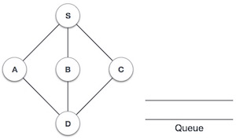
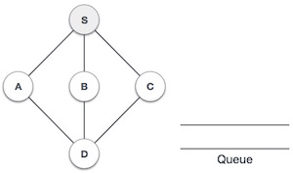
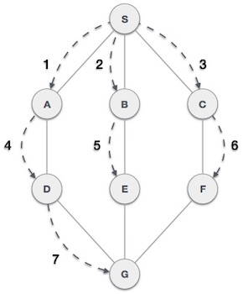
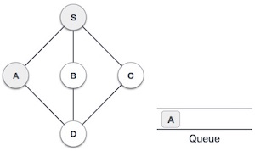
Step | Traversal | Description
1 |  | Initialize the queue.
2 |  | We start from visiting S (starting node), and mark it as visited.
3 |  | We then see an unvisited adjacent node from S. In this example, we have three nodes but alphabetically we choose A, mark it as visited and enqueue it.
Fig 2.10: BFS Iteration

Slide 10
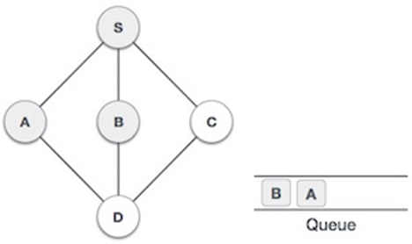
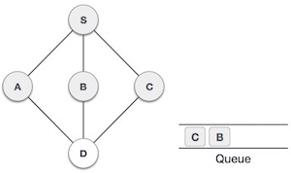
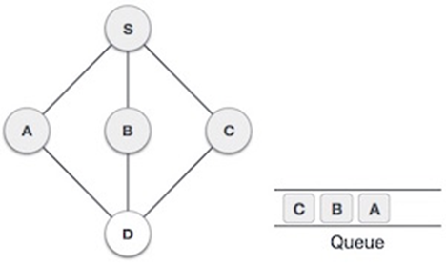
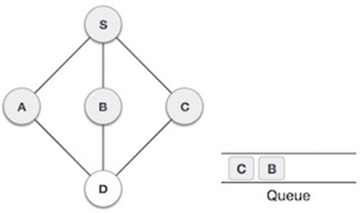
4 |  | Next, the unvisited adjacent node from S is B. We mark it as visited and enqueue it.
5 |  | Next, the unvisited adjacent node from S is C. We mark it as visited and enqueue it.
6 |  | Now, S is left with no unvisited adjacent nodes. So, we dequeue and find A.

Slide 11
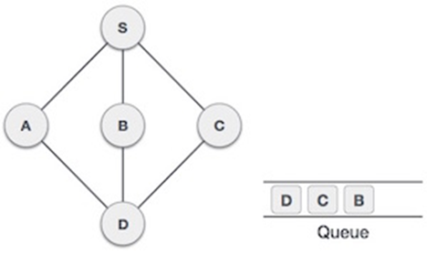
7 |  | From A we have D as an unvisited adjacent node. We mark it as visited and enqueue it.

Slide 12
Functions in program
ConvertString(String input) : Convert a given input string with no space in between to string having space before capital letter.
searchAreaIfExistOrNot(String input) : Check whether the bus stand is already present in graph or not. If present return id of bus stand else return -1.
searchDtcBus(String input) : Return bus id if it already exist in graph otherwise return -1.
InterBusStop(int id, int start, int end) : Return total no of intermmediate bus stop between start and end bus stop with bus no equal to id.
displayIntermediate(int id , int start ,int end) : Return string having name of intermediate bus stop b/w start and end with bus no equal to id.

Slide 13
6. bfsMinStop(int start,int end) : Return object of type resultPair that contain list of bus and stop where we have to interchange , total no of minimum stop and total interchange having least no of total bus stops.
7. bfsMinChange(int start ,int end ) : Return object of type resultPair that contain list of bus and stop where we have to interchange , total no of minimum stop and total interchange having least interchange.
8. bfsAllRoute (int start, int end) : Return at most 10 best routes in form of resultPair list object.
9.insert(String input ,Node root , int id) : Insert input string and id into trie tree having root object name equal to root.
10.search( String input ,Node root ) : Return list of bus stand and their id having prefix value equal to input value.

Slide 14
Overview of DTC bus guide software

Slide 15
Main
Screen

Slide 16
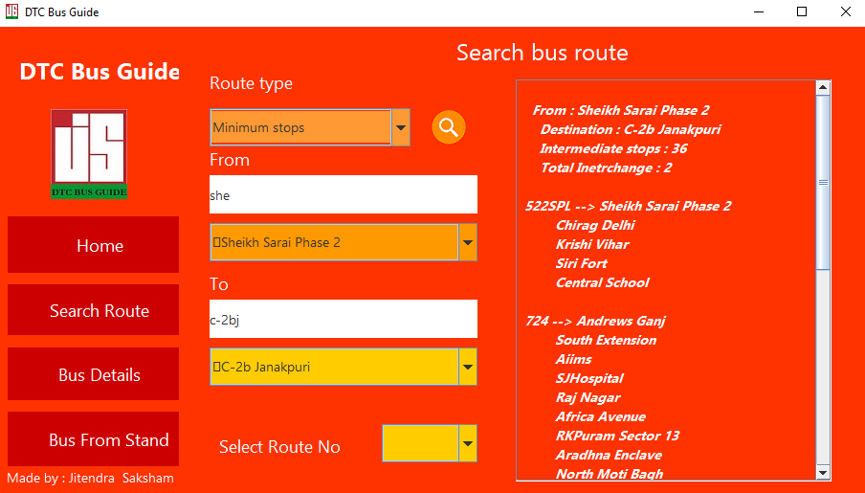
Search source bus stand
Bus route details showed here
Search
Bus
Route
Search destination bus stand

Slide 17
Search
bus
details

Slide 18
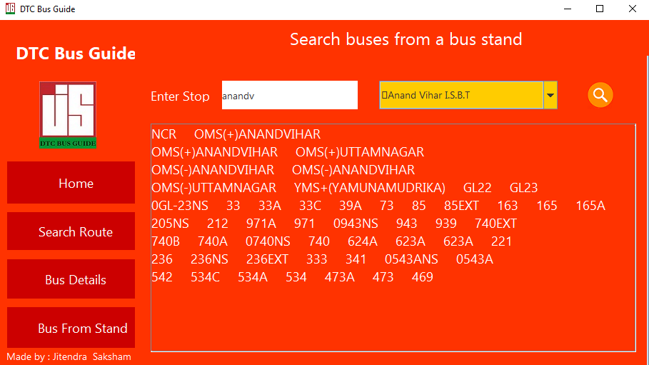
Search bus stand name
Buses from
bus stand
Select bus stand name
Bus no. will be showed here

Slide 19


